Slide 1
ALGEBRA 4
Day 58

Slide 2
Today’s Game Plan
Bell Work
Copy down things to study so you know what is on the test
Take a small OPEN NOTE quiz [turn in when done]
Work on review assignment and any missing assignments listed on the board [infinite campus is up to date as of Friday so check online if you’re not sure]

Slide 3
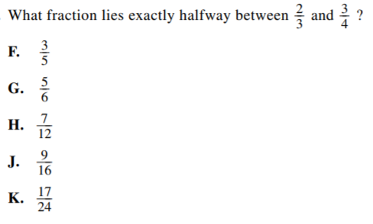
Bell Work

Slide 4
Bell Work Explained:
To find the middle of two numbers (fractions or not) we simply add the two numbers together and divide it by 2.
We can do this in the calculator (use the faction a b/c button) and add the two fractions together. Then divide the answer by 2.
Your answer is: K

Slide 5
Things to Study
Level 2:
Fundamental Counting Principal Combination & Permutation Probability Mutually Exclusive Independent vs Dependent
Level 3:
Set up & Solve Combination and Permutation Probability with multiple events
Level 4:
Set up and solve your own probability problems

Slide 6
Quiz: Level 2
You have 10 shirts and 8 pairs of pants. How many outfits could you wear?
A bag has 6 red, 4 green, and 10 blue marbles.
Find P(green) P(not red)
Is the following independent or dependent: a student flips a coin and they roll and even number on a die?

Slide 7
Quiz: Level 3
If you have 6 novels, and 4 comic books in your backpack. How many ways can you randomly select two of them to read?
A bag has 6 red, 4 green, and 10 blue marbles.
Find P(green or red) P(red then red) [with and without replacement]

Slide 8
Quiz: Level 4
The dance coach has decided to randomly choose 4 players to represent the team as captains. The team consists of 12 seniors and 8 juniors. What is the probability that only one senior will be chosen?

Slide 9
Review Assignment
Page 752 #5-31
Page 757 #1-10, 18, 20

